Slide 1
Kaggle CareerCon 2019 - Help Navigate Robots
Yongchang Feng
4/2019

Slide 2
Executive Summary
In this project, we have helped robots recognize the floor surface that they’re standing on using data from its IMU sensors.
The key aspect of our approach , which set it apart from others in the competition, is feature engineering with Fast Fourier transform (FFT).
A toolbox is developed to generate various types of spectra features.
A random forest model is used to fit the training data and predict the test data.
Model performance and ‘classifier.feature_importances_’ indicator are used in feature selection.
Good performance, which ranks in top 5% in competition, can be achieved with this very simple model (which runs only a few minutes on a pc without GPU).
A few ideas for further improvement are also proposed.

Slide 3
Introduction
Robots are smart by design. To fully understand and properly navigate a task, however, they need input about their environment.
In this competition, we’ll help robots recognize the floor surface they’re standing on using data collected from Inertial Measurement Units (IMU sensors), which were collected while driving a small mobile robot over different floor surfaces.
The task is to predict which one of the nine floor types the robot is on using sensor data. This would help improve the navigation of robots across different surfaces.
The dataset:
X_[train/test] - the input data,10 sensor channels and 128 measurements per time series
The 10 sensor channels are: orientation_X / orientation_Y / orientation_Z / orientation_W / angular_velocity_X / angular_velocity_Y / angular_velocity_Z / linear_acceleration_X / linear_acceleration_Y / linear_acceleration_Z
y_train.csv - the surfaces for training set.
https://www.kaggle.com/c/career-con-2019/overview/description

Slide 4
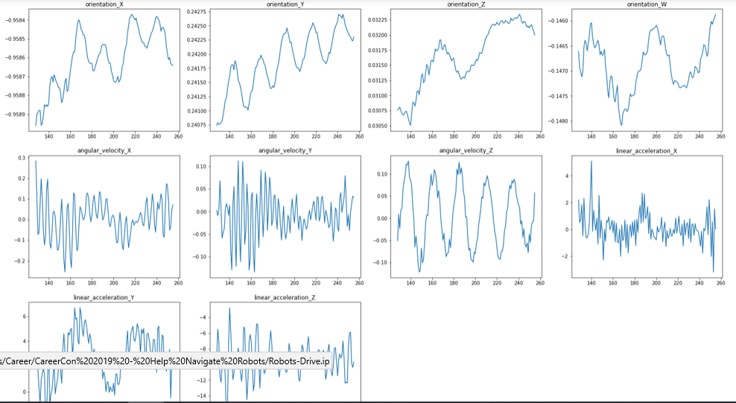
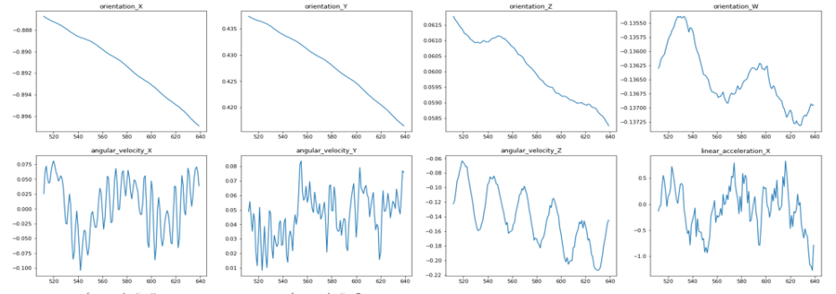
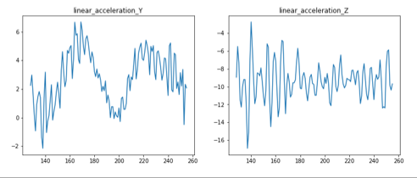
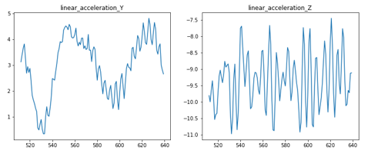
Exploratory Data Analysis
Here shown examples of the sensors’ signals on two different surfaces
It is not obvious what are the key characteristics (features) which could differentiate them
More examples in the appendix
Concrete Fine Tiles

Slide 5
The Approach (why FFT?)
Data from the sensors are time series of orientation, velocity etc. of the robot. As the robot can have the same orientation and velocity on different surfaces, these parameters may not decide (predict) the surfaces directly.
However, one idea is that the robot will vibrate in differently on different surfaces.
In physics / mechanical engineering, it is easier to analyze vibration in frequency domain.
Fourier analysis converts a signal from its original domain (often time) to a representation in the frequency domain.
Fast Fourier transform (FFT) is an algorithm that computes the discrete Fourier transform (DFT) of a sequence, or its inverse (IDFT).
In this project, FFT is applied on the dataset and FFT based features are explored.
https://en.wikipedia.org/wiki/Fast_Fourier_transform#:~:text=A%20fast%20Fourier%20transform%20(FFT,frequency%20domain%20and%20vice%20versa.
https://www.reliableplant.com/vibration-analysis-31569

Slide 6
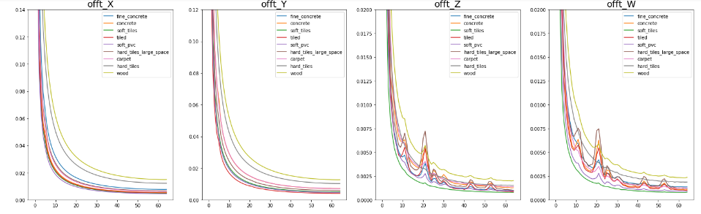
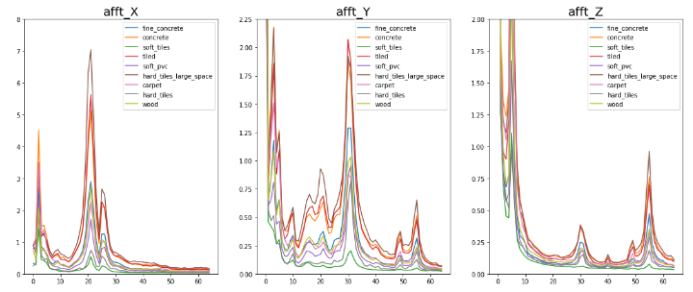
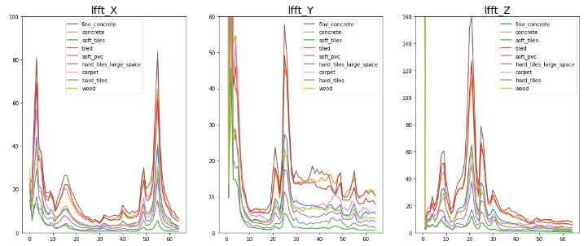
Average Spectra
Overall level
Missing peak
Average spectra for each type of surface from each channel are shown
The spectra are characterized by overall levels, distinct peaks and noise level in certain zooms.
peak
Acknowledgment:
Thank Tue Ngo for code which generates these platting.
Noise

Slide 7
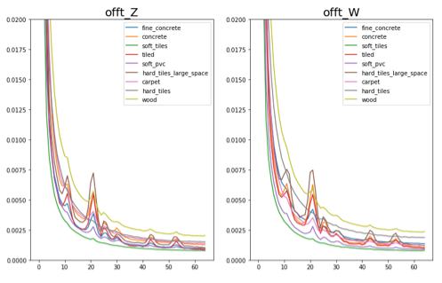
Feature Engineering – Generating Features
Various types of features:
1. Area under curve (for overall level)
2. Peaks
Intensity include background
Intensity exclude background
Intensity ratio of two peaks
Total power (area) of a peak
3. Noise level (at where no peak)
4. Spectrum stability (FFT on different sections of the time series)
5. Could apply smoothing (moving average) on the curves
Peak
Overall level

Slide 8
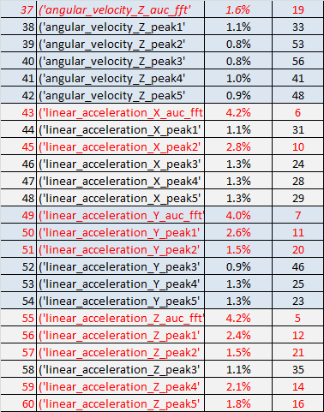
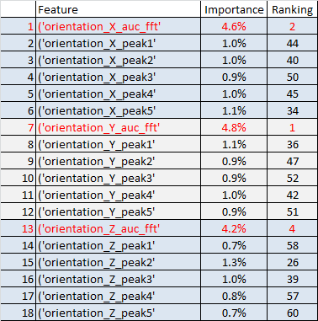
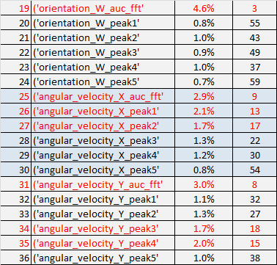
Feature Engineering – Selecting Features
It is important to select only the significant features.
Remove features which are lest significant based on random_forest’s 'classifier.feature_importances_'.
Finally, optimized based on model performance.
AUC type of features are the most significant.
Here shown an example.
Importance Ranking

Slide 9
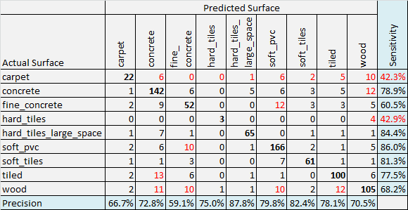
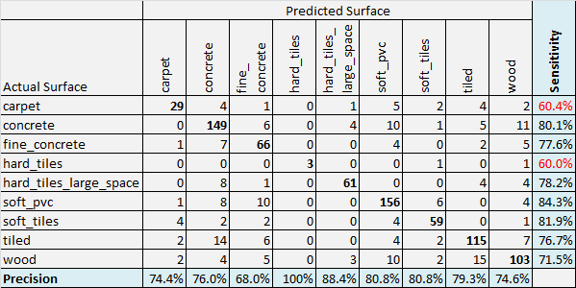
Results and Discussions
Case1 – use AUC features only. Overall accuracy: 75.1%
A Random Forest model is used for prediction
Set class_weight = 'balanced'
Here shown two examples:
In Case1, only area_under_curve (AUC) type of features are selected. Overall accuracy is 75.1%.
In Case2, AUC and peak types of features are selected, overall accuracy improves to 77.8%, and the two worst sensitivity measures also improved.
Results of this very simple model ranks in top 5% of this competition.
Case2 – use AUC and some peak features. Overall accuracy: 77.8%

Slide 10
Ideas for Future Works
Here are some ideas for further improvement:
Split train / validation considering group_id to prevent potential data leakage
Use k-fold validation strategy
Use data augmentation to increase sample size – use only a random section of a time series (128 points) for FFT
Explore XGBoost or model ensemble

Slide 11
Summary
In this project, we have helped robots recognize the floor surface that they’re standing on using its IMU sensors data.
The key aspect of our approach, which set it apart from others in the competition, is feature engineering with Fast Fourier transform (FFT).
A toolbox is developed to generate various types of spectra features.
A random forest model is used to fit the training data and predict the test data.
Model performance and 'classifier.feature_importances_‘ indicator are used in feature selection.
Good performance, which ranks in top 5% in competition, can be achieved with this very simple model (which runs only a few minutes on a pc without GPU).
A few ideas for further improvement are also proposed.
Link to the notebook:

Slide 12
Appendix

Slide 13
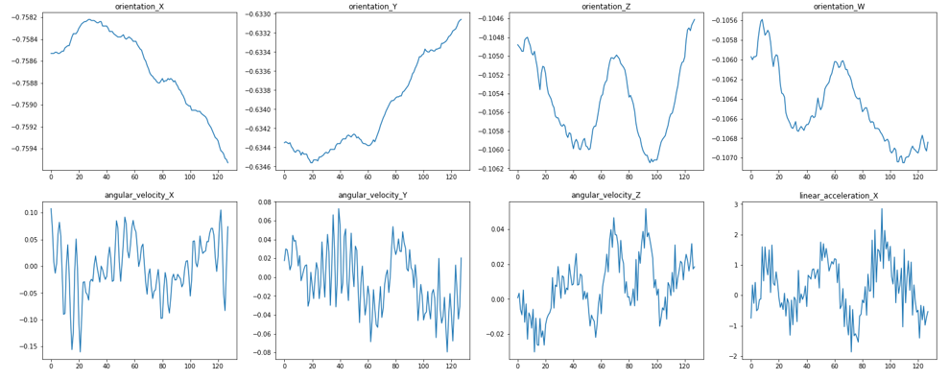
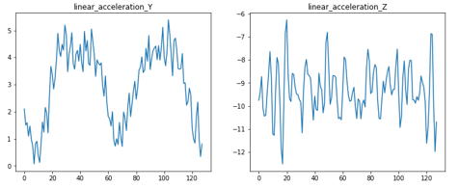
0. Fine_concrete

Slide 14
1. Concrete

Slide 15
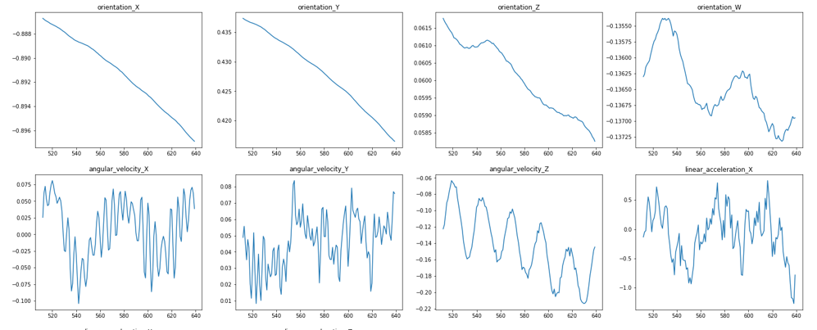
4. Soft_tiles

Slide 16
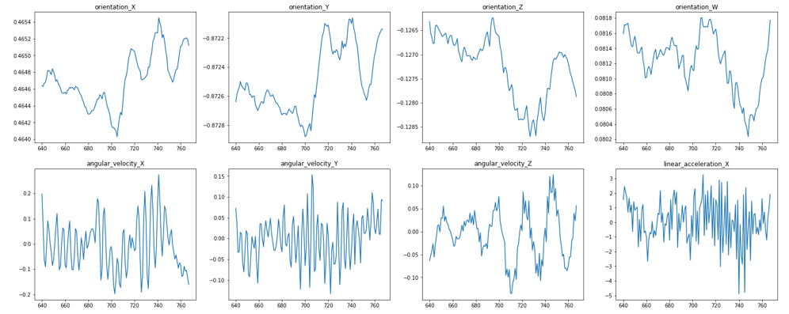
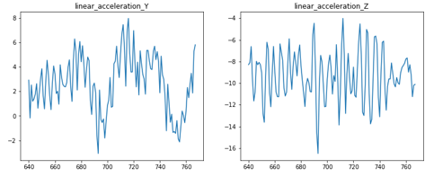
5. Tiles

Slide 17
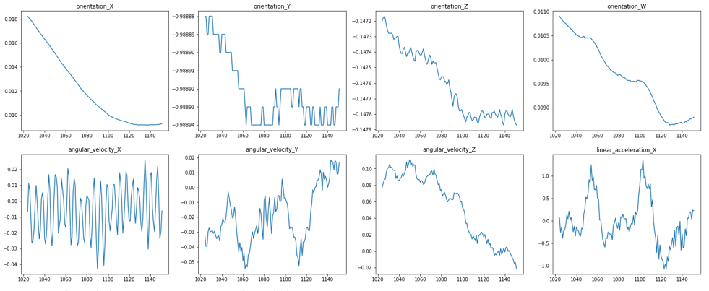
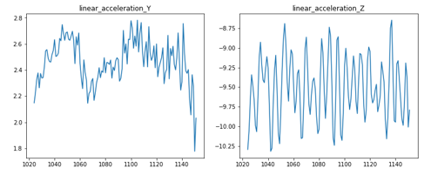
8. Hard_tiles_large_space

Slide 18
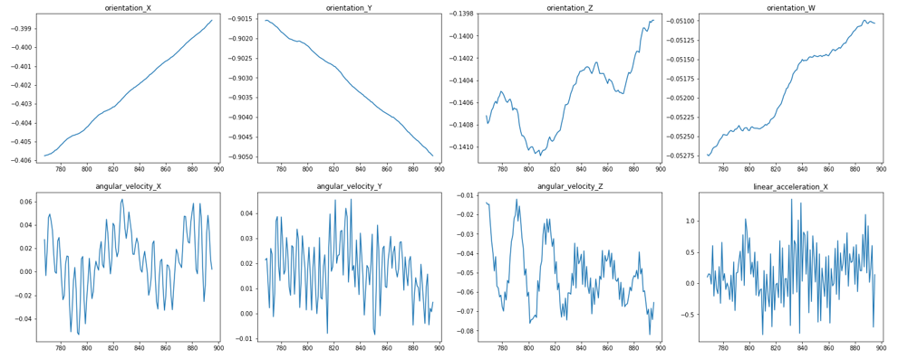
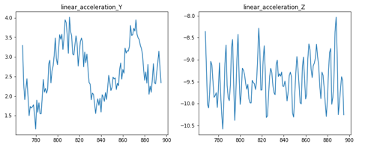
6. soft_pvc

Slide 19
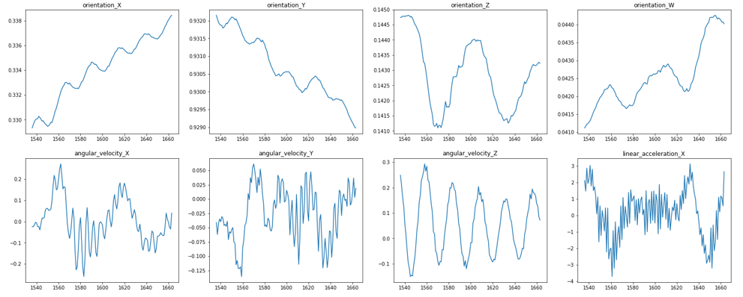
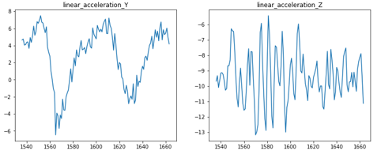
12. Carpet

Slide 20
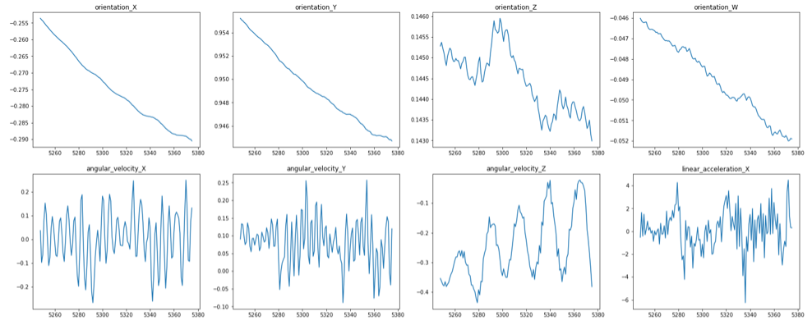
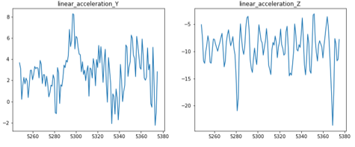
41. Wood

Slide 21
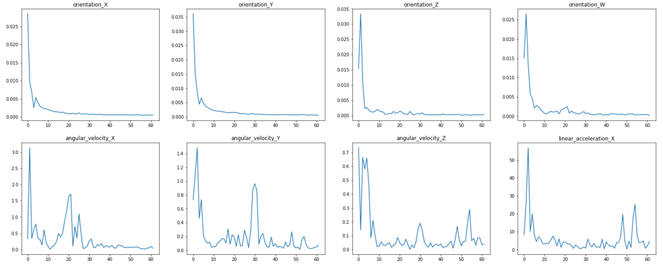
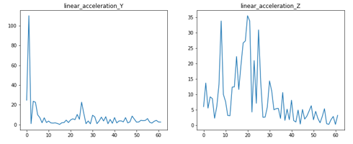
0. fine_concrete FFT

Slide 22
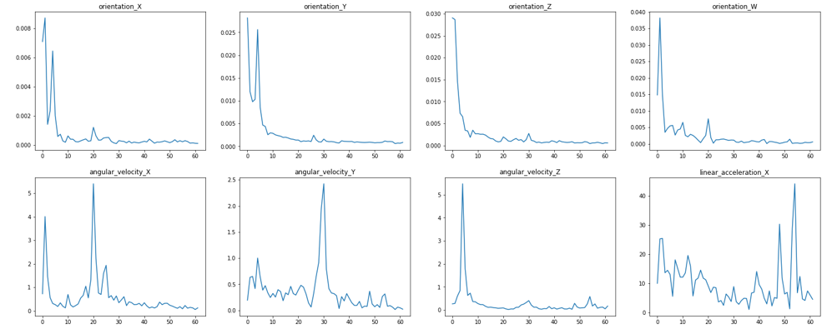
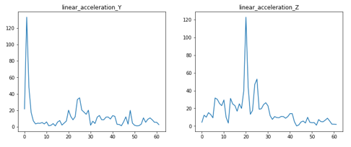
1. Concrete FFT

Slide 23
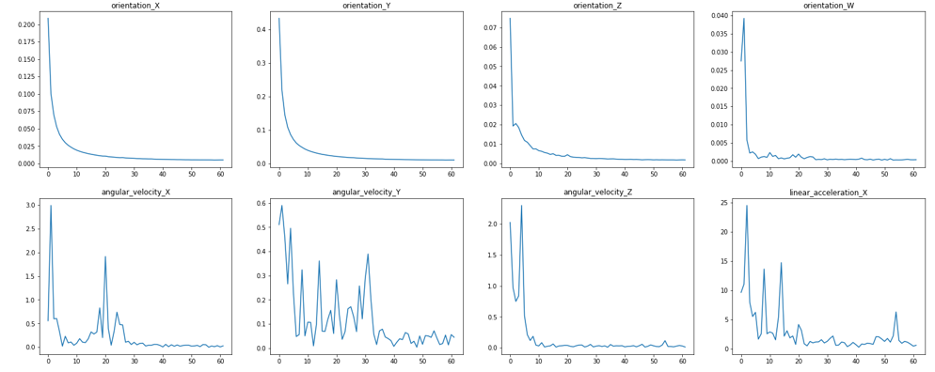
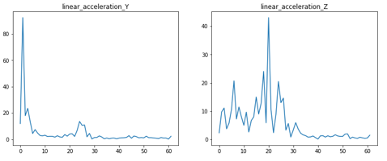
4. Soft_tiles FFT

Slide 24
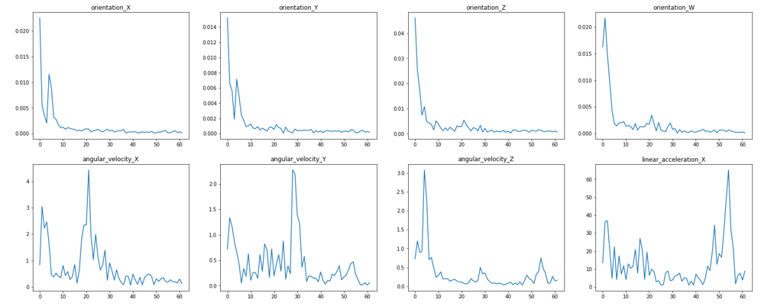
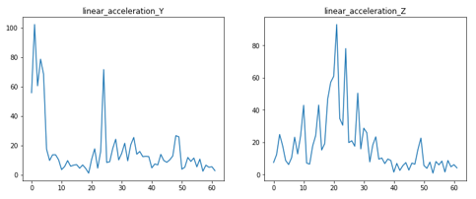
5. Tiles FFT

Slide 25
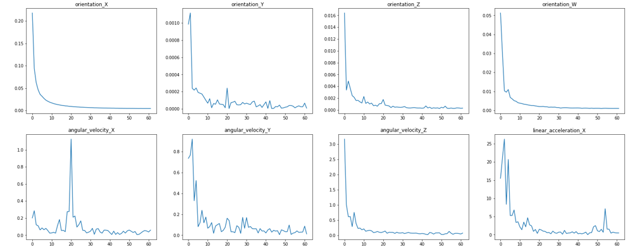
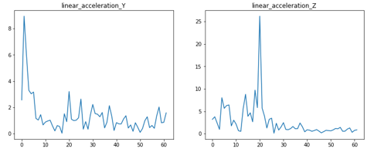
8. hard_tiles_large_space FFT

Slide 26
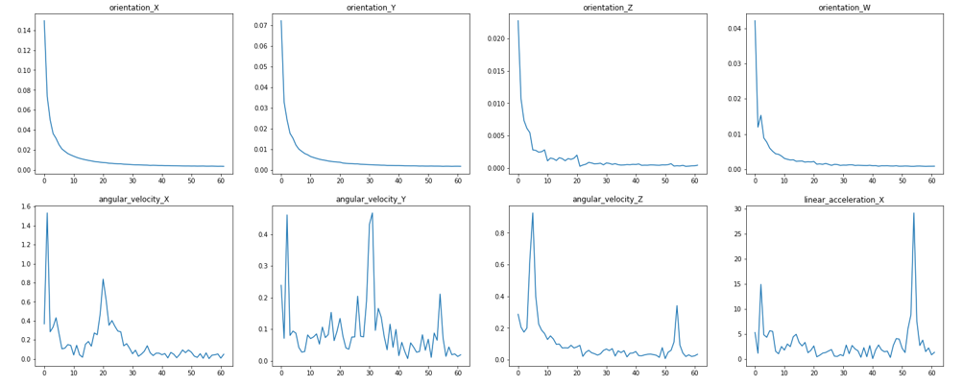
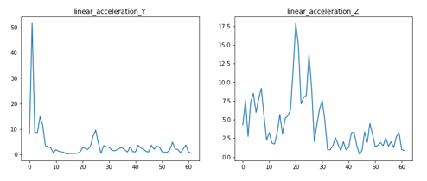
6. Soft_pvc FFT

Slide 27
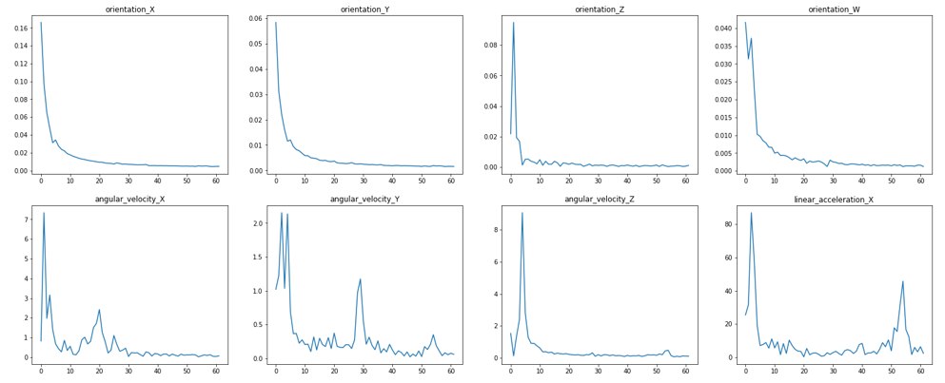
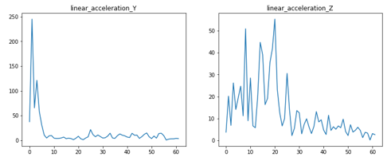
12. Carpet FFT

Slide 28
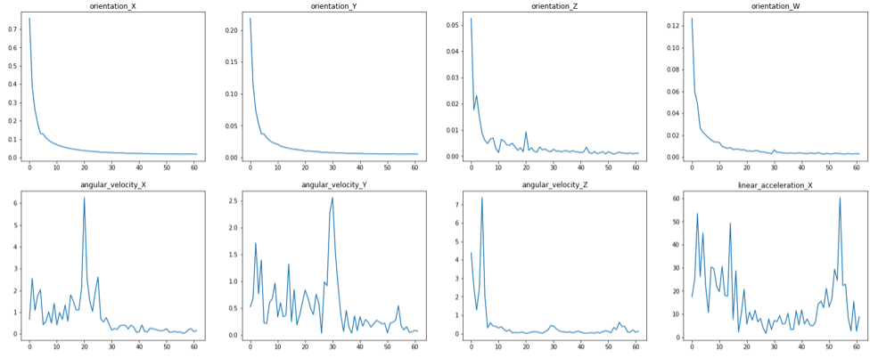
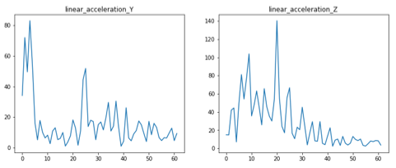
41. Wood FFT

